Slide 2
Background
Goal: Using faust to create a plug-in and instrument to use in Logic Pro X
Problem: Logic Pro X only supports AudioUnit format
Multiple Approaches:
faust2au ❌ didn‘t work for us
faust2juce -> juce ✅ worked
faust2cpp (engine) -> juce/ build yourself ✅ kind of worked
faust2vst(i) -> metaplugin ✅ worked
Different results!

Slide 3
faust2vst
Develope Code in (Online)Editor. Here: FaustIDE (https://faustide.grame.fr)
Advantage: no need to install VST-Developement Kit
Export as (OSX) vst
Start Metaplugin in Logic Pro X
(if your DAW supports vst, skip )
Requirements: Plugin must be able to open vst-files
Recommendation: Metaplugin (free version ☺)

Slide 4
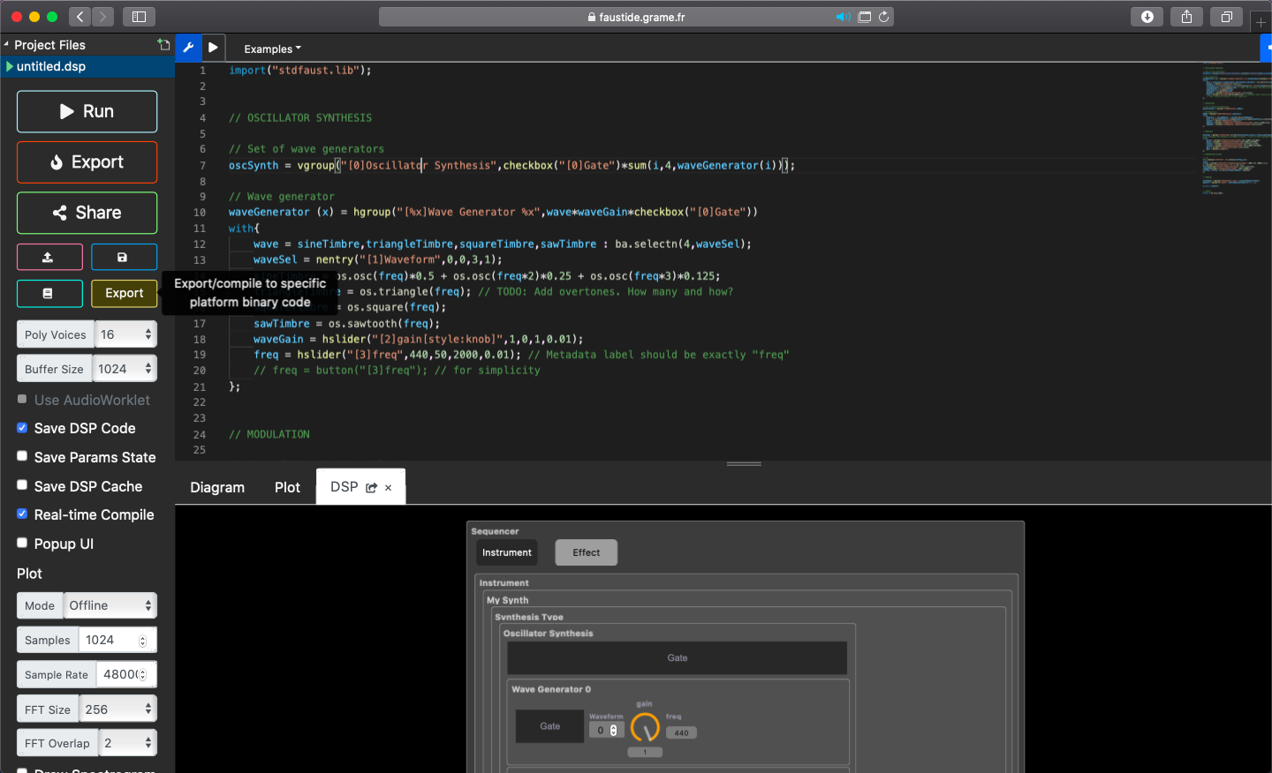
faust2vst -> -metaplugin: Step 1
So wird das vst-Plugin
später NICHT aussehen…

Slide 5
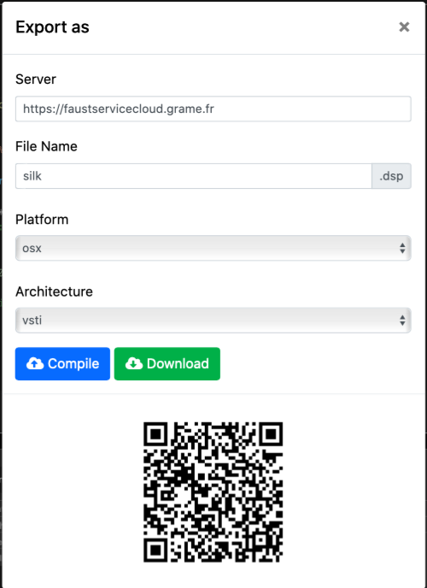
faust2vst -> -metaplugin: Step 2
For Plugins on Mac use:
Platform: osx
Achitecture: vsti/vst
Use vsti for instruments and vst for effects
Both will be .vst-files, but they will end up in different
„slots“ in Logic
Press download after compiling

Slide 6
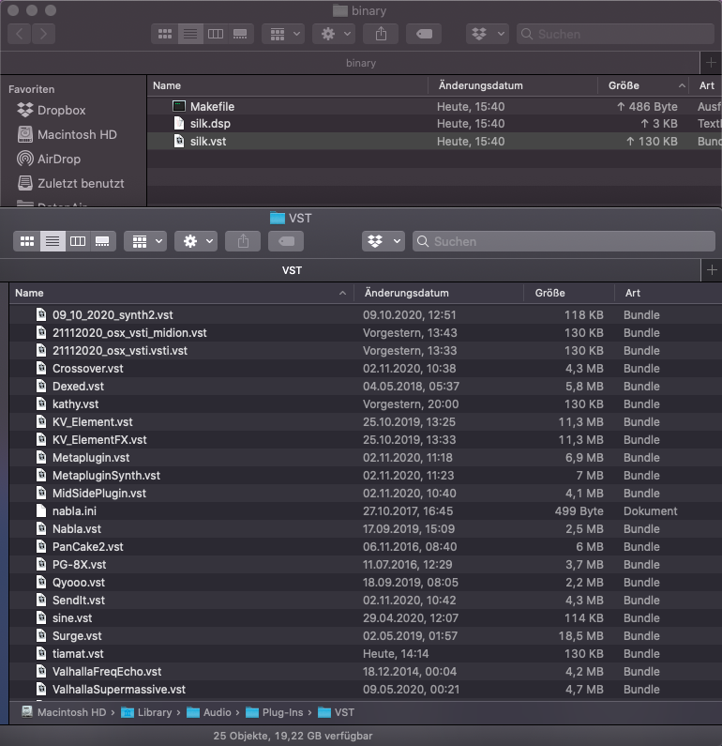
faust2vst -> -metaplugin: Step 3
.vst-file will be downloaded as .zip file in this folder
Additionally you will find the faust code and a makefile,
both you will not need for the rest of this tutorial
Move .vst-file to VST-Path
(Should be the same for Mac users)
Macintosh HD > Library > Audio > Plug-Ins > VST
You might need admin rights for this.

Slide 7
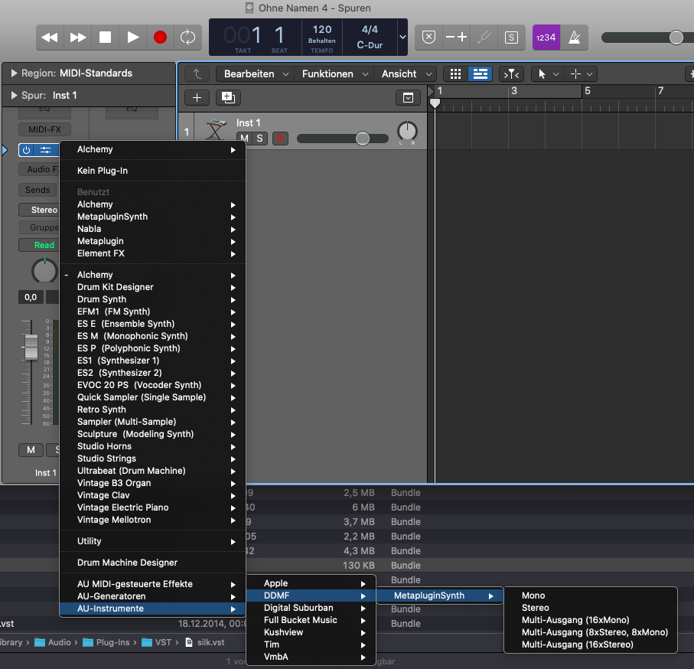
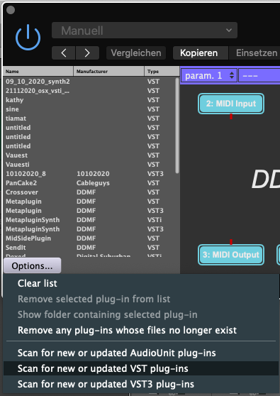
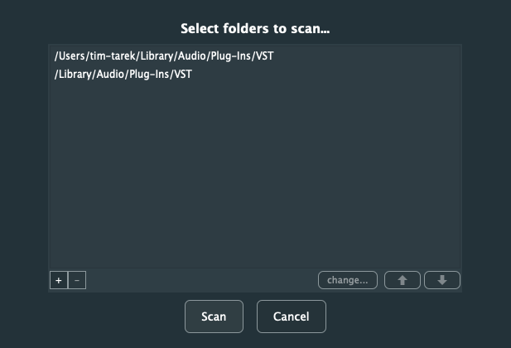
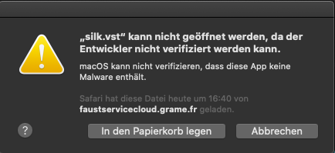
faust2vst -> -metaplugin: Step 4
Translation:
Cant be opened, since developer is not verified
(Great feature, but very disruptive for this
workflow). Press question mark.

Slide 8
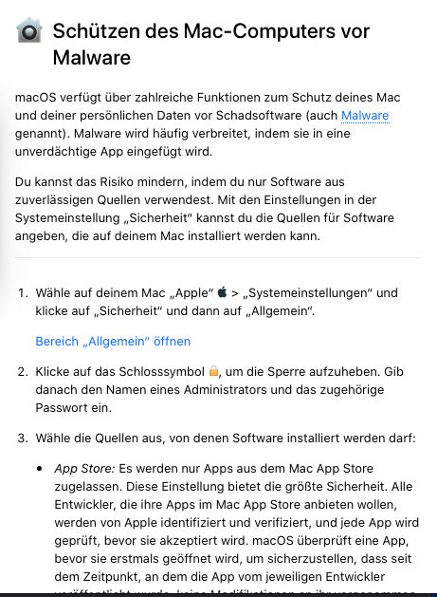
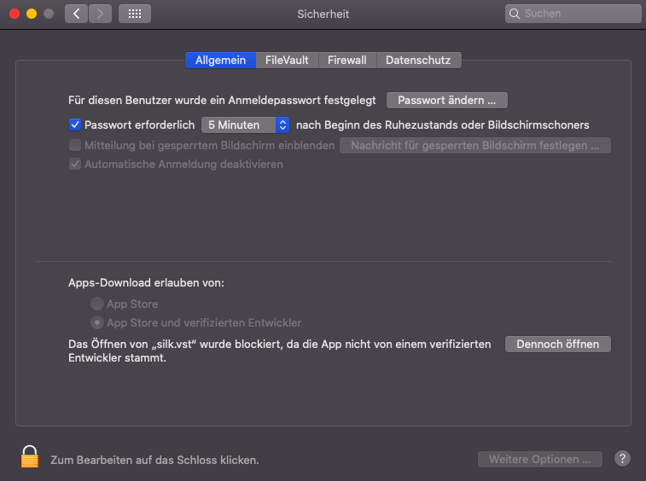
faust2vst -> -metaplugin: Step 4.5
Follow the link that leads you to your safety settings.
Allow your vst to be openend by pressing the button.

Slide 9
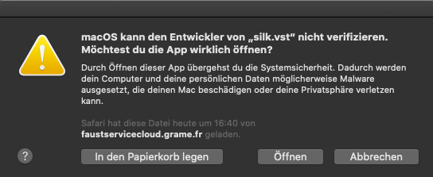
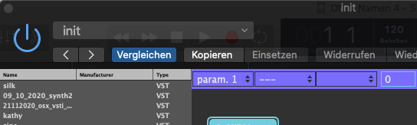
faust2vst -> -metaplugin: Step 5
3. Hit scan
Open your
wrapper-plugin
(here: MetapluginSynth,
Since we built a synth)
2. press scan again
5. Scan again
4. Press open
6. There is your plugin!

Slide 10
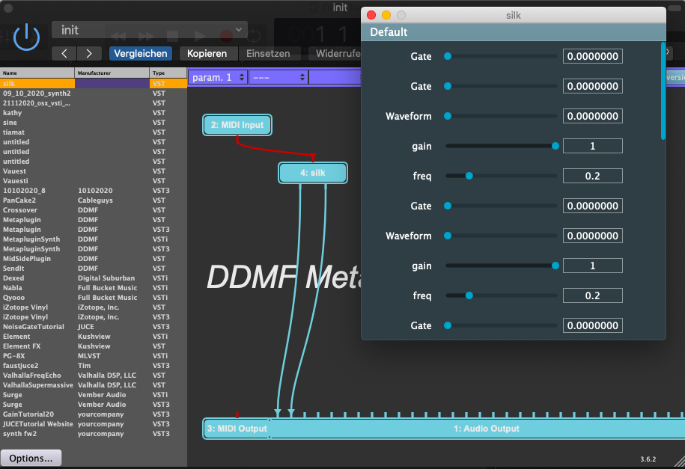
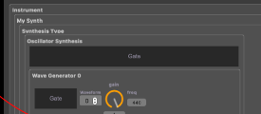
faust2vst -> -metaplugin: Step 6
Noq you are able to open your plug in within Metaplugin within Logic Pro X
Big drawback:
All GUI parameters are sliders (No knobs, checkboxes, etc.)
For comparison:

Slide 11
faust2vst -> -metaplugin: Fazit
PRO | CONTRA
Moving very fast from faust code to plug-in | No midi support
No additional programming needed | Layout very counter intuitive
No additional programming knowledge needed | MIDI Mapping not possible
No need to install additional requirements | GUI-slider range of values [0, 1]
 | Only GUI-slider elements
Applications of this workflow:
- Effect-plugins (vst instead of vsti), (No MIDI needed)
- One-Slider instruments
- Drones
- Sounddesign

Slide 12
faust2juce
get basic Juce plug-in running in Logic Pro X
If not found in Logic, delete AudioUnitCache
export faust code as faust2juce
Juce plugin midi poly 16 works
add faust2juce code to juce project

Slide 13
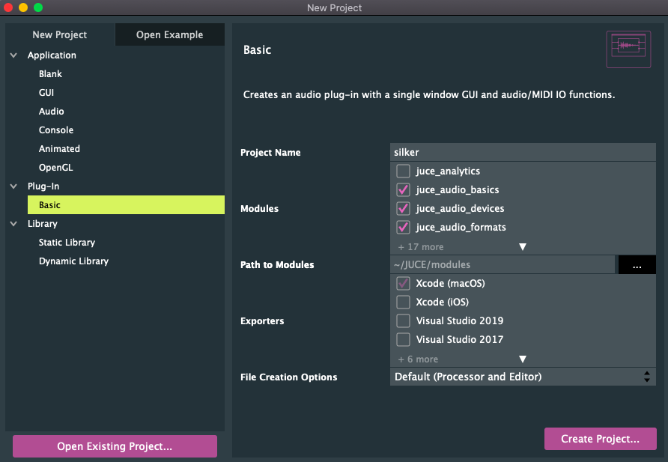
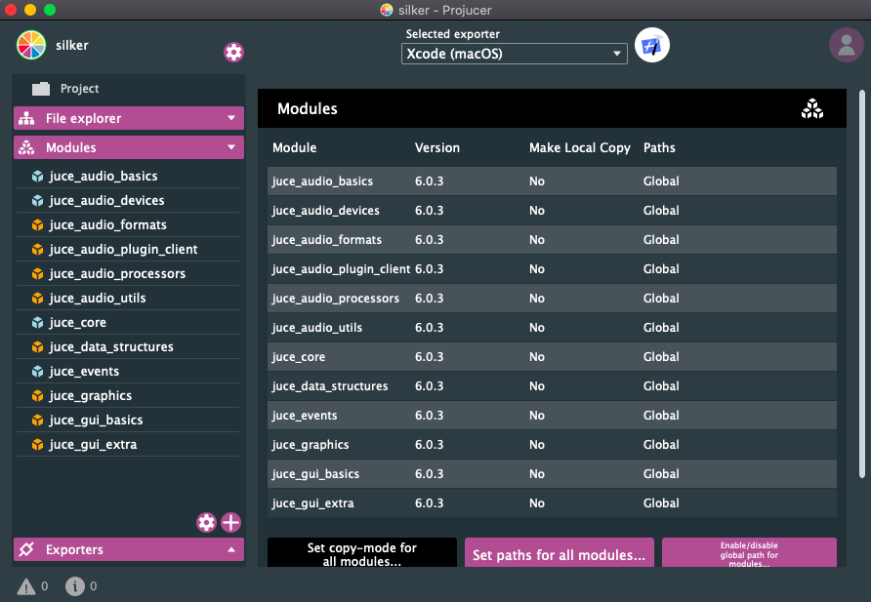
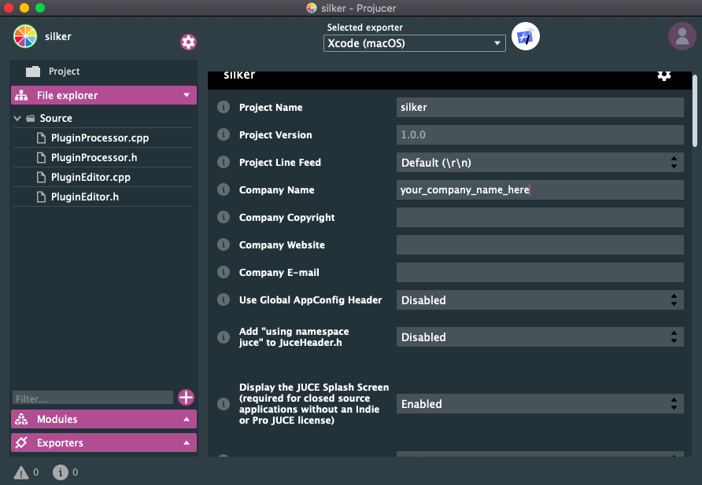
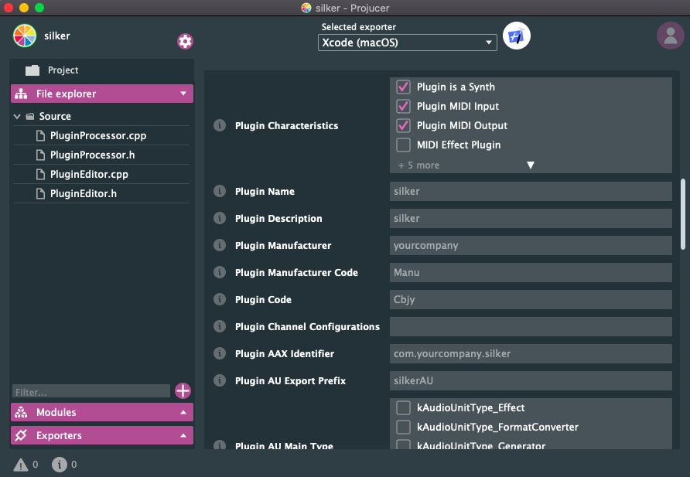
faust2juce: Getting a juce plug-in running
Set/keep path as Global
Start the Projucer with a basic Plug-In
Add (any)
company name and open in IDE
Check: Synth
Midi input
Midi Output

Slide 14
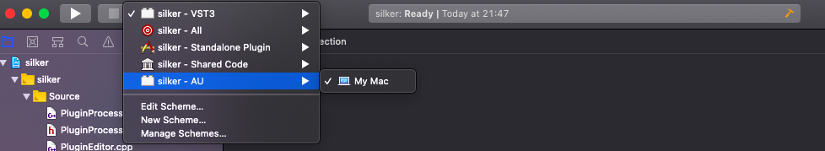
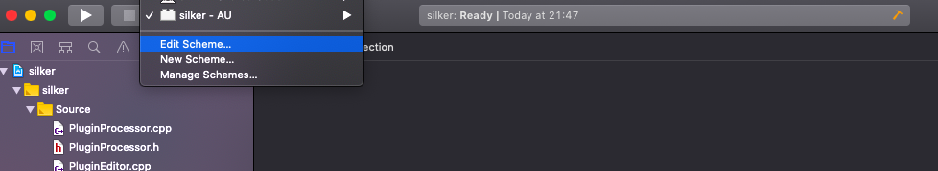
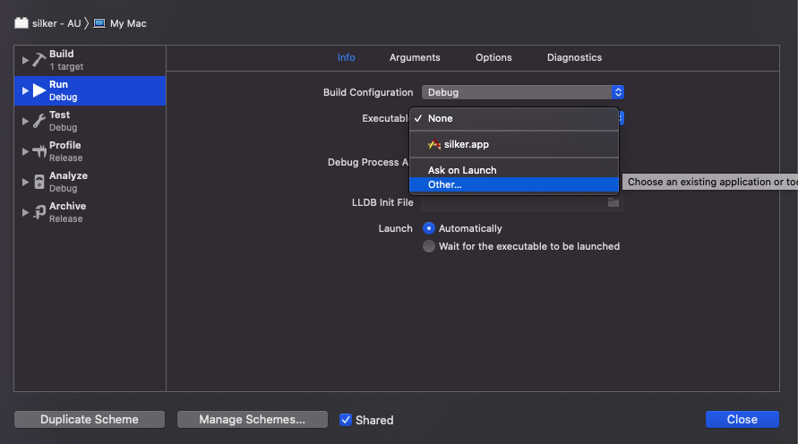
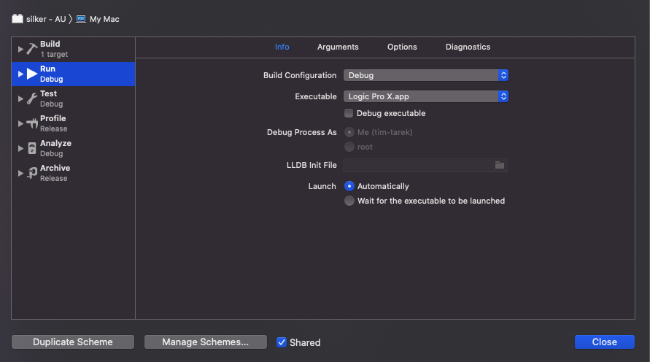
faust2juce: Getting a juce plug-in running, Part II
Change scheme to AU
Edit scheme
Change debug executable (to Logic)
And de-tick [debug executable]

Slide 15
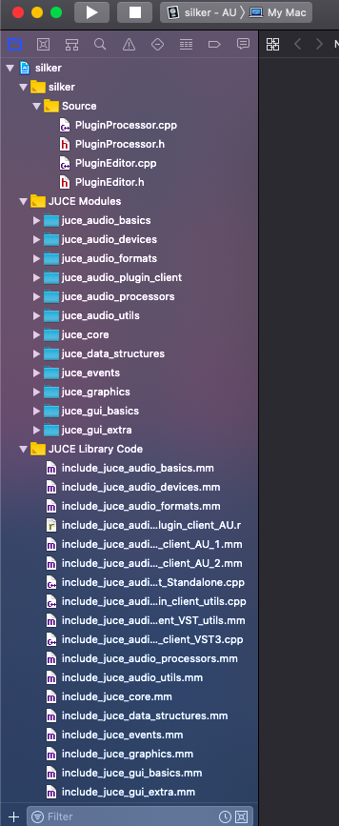
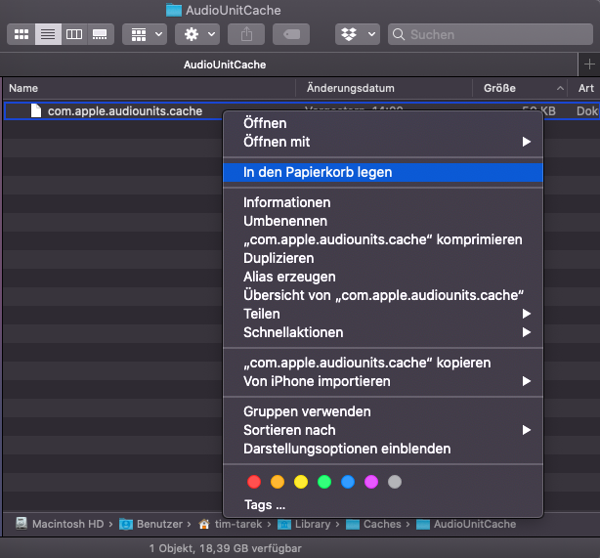
faust2juce: Getting a juce plug-in running, Part III
Build and open Logic
If you can‘t find your plug-in under your_company_name try deleting the AudioUnitCache and restart your Mac

Slide 16
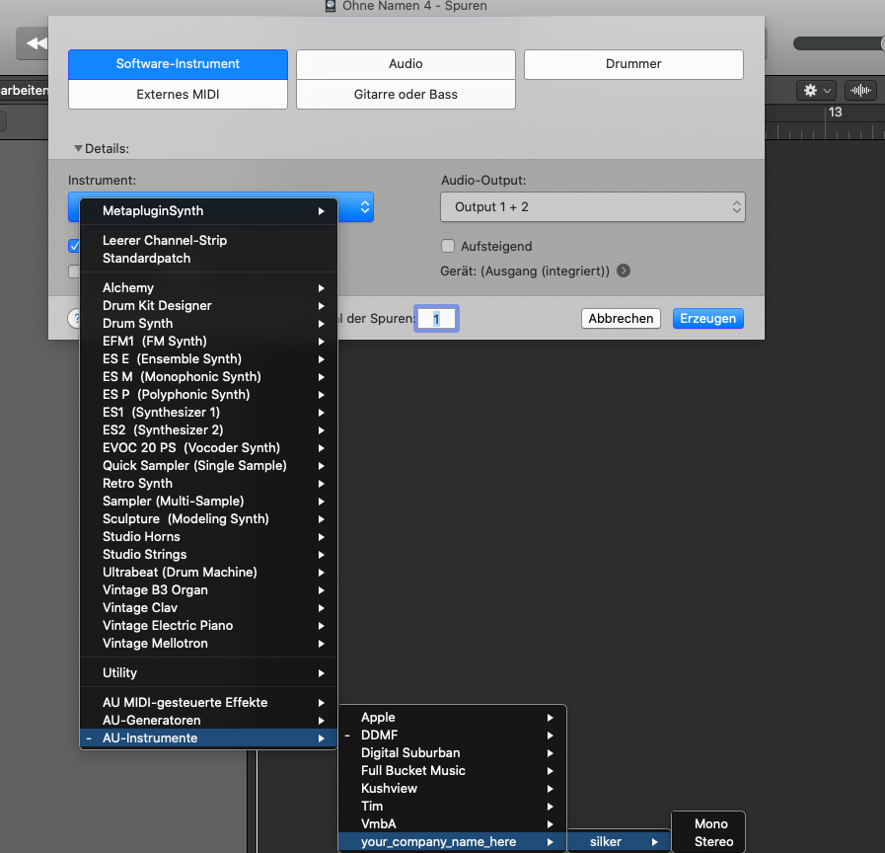
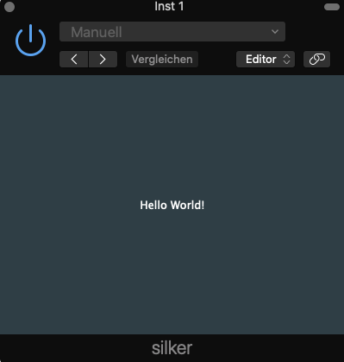
faust2juce: Getting a juce plug-in running, Part IV

Slide 17
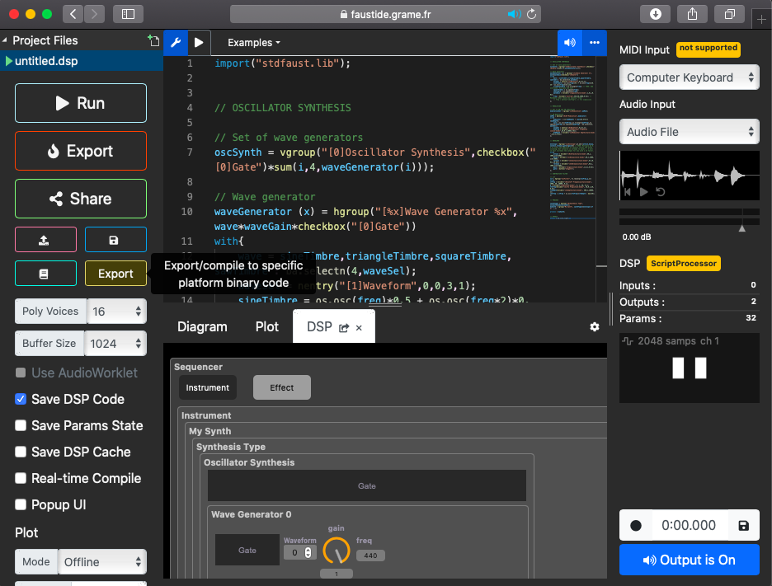
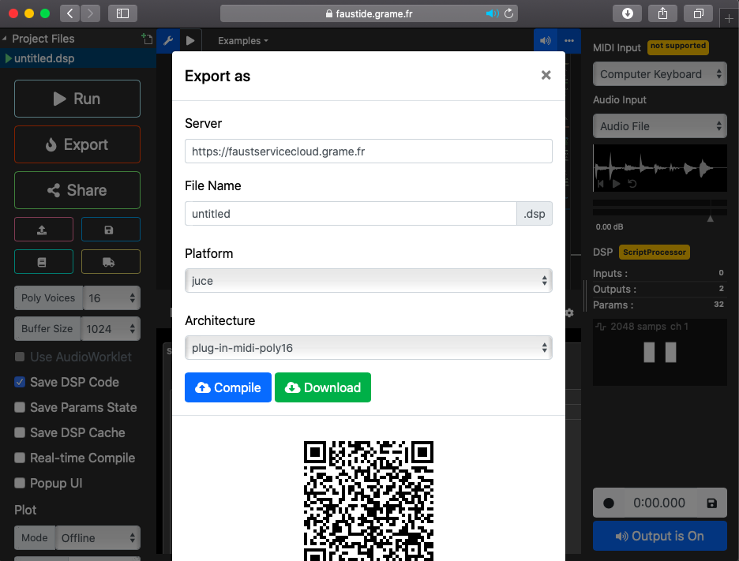
faust2juce: Adding your own faust code

Slide 18
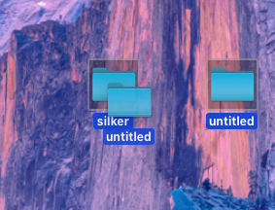
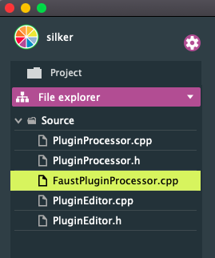
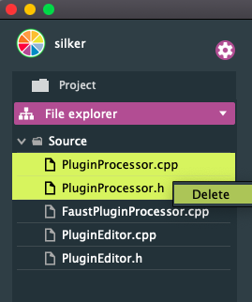
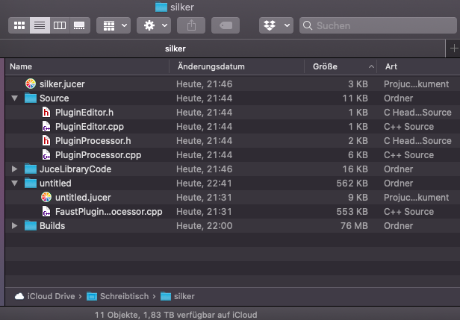
faust2juce: Adding your own faust code, Pt. II
For keeping track of your project, add the folder containing the exported code (untitled) to your project folder (the one containing your JUCE project
Overview of your project folder
Now open the jucer file of your the already working juce project
Add the FaustPluginProcessorFile to your Source files (drag and drop into the Projucer) and delete the existing PluginProcessor files

Slide 19
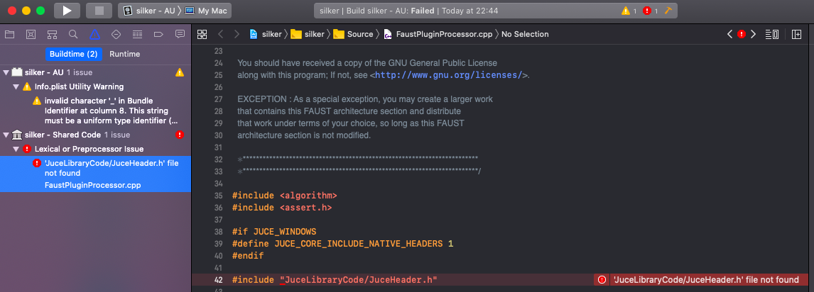
faust2juce: Adding your own faust code, Pt. III
If you open the project in your IDE, you will probably get this error message
Just change this line to

Slide 20
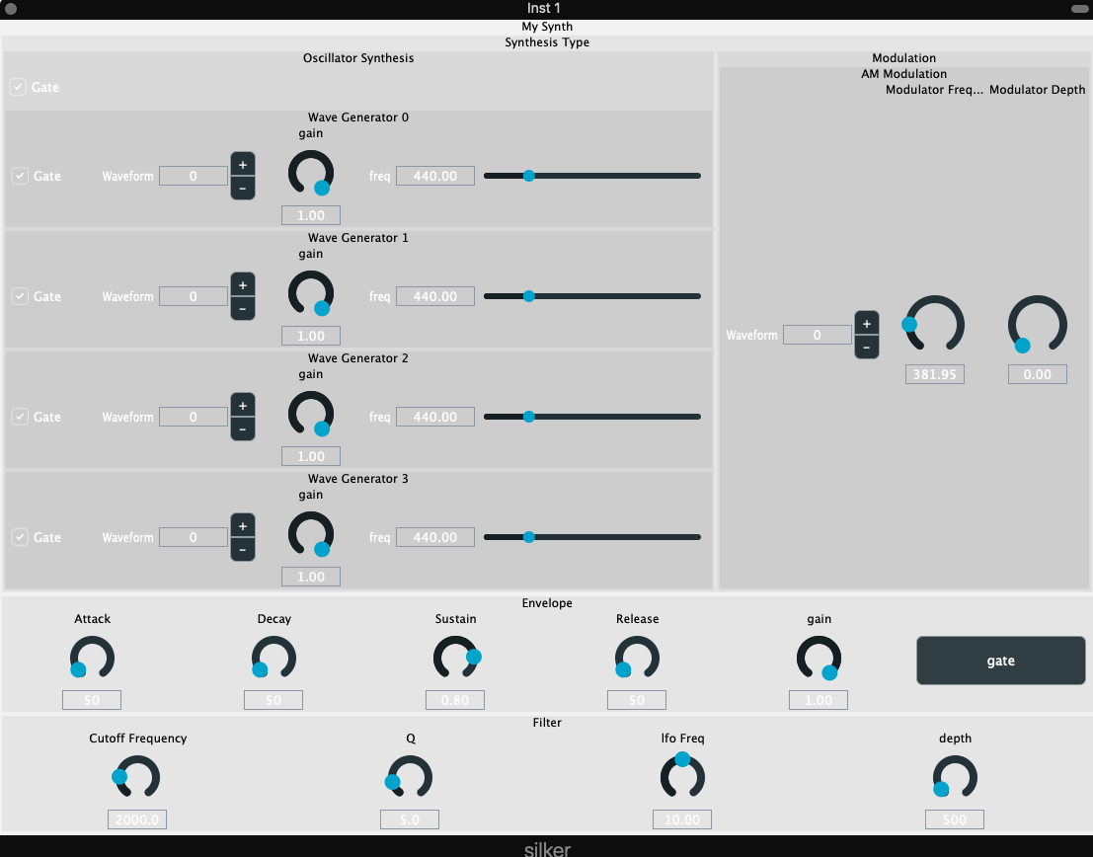
faust2juce: The final product
If you open your plug-in now, it should display the regular look now

Slide 21
faust2juce: Fazit
PRO | CONTRA
Aesthetically pleasing ☺ | Still no MIDI support, but probably fixable using juce
Limited amount of understanding of code needed in general | More amount of coding knowledge needed than for faust2vst
Intuitive GUI (faust) (& actual GUI elements) | A lot of things can go wrong
Midi-Mapping possible! | Very discouraging workflow
 | Need of installation (and a little understandin)g of JUCE
 | Takes more time than faust->vst
Applications of this workflow:
- Building performable instruments
- Build understanding of how plug-ins and plug-in environments work during workflow

